Slide 1
CHAPTER 5 :-File Management System
File:- is a named collection of related information that is recorded on secondary storage.
A file is collection of specific information stored in the memory of computer system. In general, a file is a sequence of bits, bytes, lines or records which is collection of related fields.
File management is defined as the process of manipulating files in computer system, it management includes the process of creating, modifying and deleting the files.
File management is one of the basic and important features of operating system.

Slide 2
Operations of files performed by os
It specifies the task that can be performed on a file such :-Creating, Updating files, Reading files, writing files, Deleting, Opening, Closing, Appending, Seeking, Getting attributes, Setting Attributes and Renaming file.
That means:-
It helps to create new files in computer system and placing them at the specific locations.
It helps in easily and quickly locating these files in computer system.
It makes the process of sharing of the files among different users very easy and user friendly.
It helps to stores the files in separate folders known as directories. These directories help users to search file quickly or to manage the files according to their types or uses.
It helps the user to modify the data of files or to modify the name of the file in the directories.

Slide 3
Directory files
All the data on your hard drive consists of files and folders. The basic difference between the two is that files store data, while folders store files and other folders.
The folders, often referred to as directories, are used to organize files on your computer.
The folders themselves take up virtually no space on the hard drive. Files, on the other hand, can range from a few bytes to several gigabytes. They can be documents, programs, libraries, and other compilations of data.

Slide 4
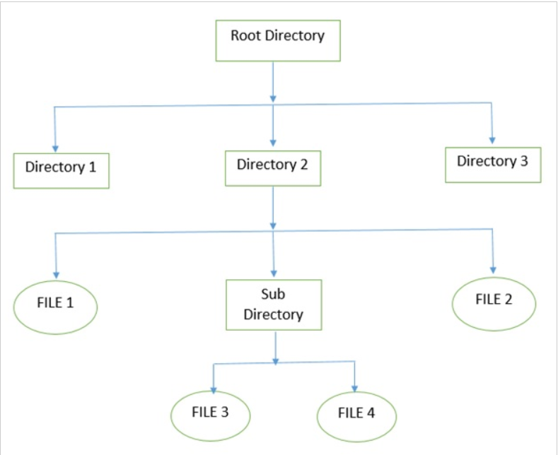
Cont…

Slide 5
File Structure
File structure is a structure, which is according to a required format that operating system can understand.
A file has a certain defined structure according to its type.
A text file is a sequence of characters organized into lines.
A source file is a sequence of procedures and functions.
An object file is a sequence of bytes organized into blocks that are understandable by the machine.
When operating system defines different file structures, it also contains the code to support these file structure.

Slide 6
File Attributes
It specifies the characteristics of the files such as type, date of last modification, size, location on disk etc.
File attributes help the user to understand the value and location of files. It is uses to describe all the information regarding particular file.
Name – only information kept in human-readable form.
Identifier – unique tag (number) identifies file within file system
Protection – controls who can do reading, writing, executing
Information about files are kept in the directory structure, which is maintained on the disk.

Slide 7
File Type– Name, Extension
File type refers to the ability of the operating system to distinguish different types of file such as text files source files and binary files etc.
A common technique for implementing file types is to include the type as part of the file name.
Many operating systems support many types of files. Operating system like MS-DOS and UNIX has the following types of files.
The name is split into two parts: a name and an extension.
Following table gives the file type with usual extension and function.

Slide 8
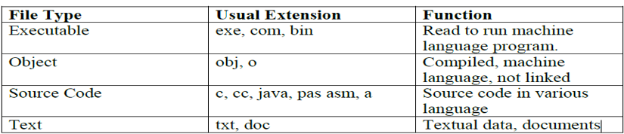
Cont…

Slide 9
File Access Mechanisms
File access mechanism refers to the manner in which the records of a file may be accessed.
There are several ways to access files
1,Sequential access :-A sequential access is that in which the records are accessed in some sequence i.e. the information in the file is processed in order, one record after the other.
This access method is the most primitive one.
Example: Compilers usually access files in this fashion.

Slide 10
Cont…
2,Direct/Random access
Random access file organization provides, accessing the records directly.
Each record has its own address on the file with by the help of which it can be directly accessed for reading or writing.
The records need not be in any sequence within the file and they need not be in adjacent locations on the storage medium.

Slide 11
Indexed sequential access
This mechanism is built up on base of sequential access.Index is searched sequentially and its pointer is used to access the file directly.
Indexed Sequential” is a concept of how information in a file can be organized, rather than a single defined file structure. It has many implementations.
Each record has a range of bytes in it which constitutes a “key”, such as account number, personal ID number, and etc.
When the file is initially loaded, they are sorted so they are in sequence based on that key.
There is an index that makes it possible to retrieve up a record by its key value.
The index lookup system knows how to find them there.
Records can be read based on the index key, by index lookup and retrieval.
After an indexed read, subsequent records can read in sequence. This is called skip-sequential access.

Slide 12
Space Allocation(File Allocation Methods)
The allocation methods define how the files are stored in the disk blocks by operating system. There are three main disk space or file allocation methods.
Contiguous Allocation
Linked Allocation
Indexed Allocation
The main idea behind these methods is to provide:
Efficient disk space utilization.
Fast access to the file blocks.
All the three methods have their own advantages and disadvantages

Slide 13
1. Contiguous Allocation
In this scheme, each file occupies a contiguous set of blocks on the disk. For example, if a file requires n blocks and is given a block b as the starting location, then the blocks assigned to the file will be: b, b+1, b+2,……b+n-1.
This means that given the starting block address and the length of the file (in terms of blocks required), we can determine the blocks occupied by the file.
The directory entry for a file with contiguous allocation contains
Address of starting block
Length of the allocated portion.
The file ‘mail’ in the following figure starts from the block 19 with length = 6 blocks. Therefore, it occupies 19, 20, 21, 22, 23, 24 blocks.

Slide 14
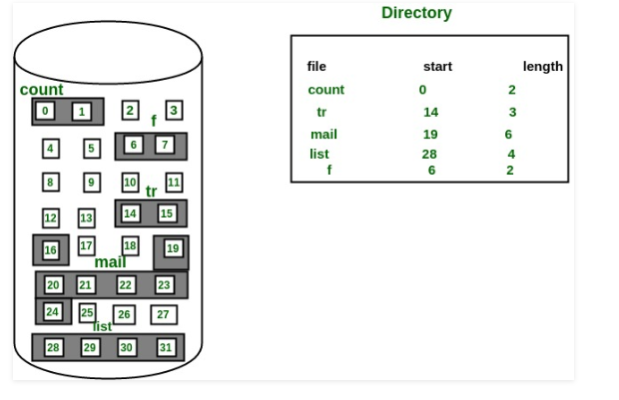
Cont…

Slide 15
Advantages:
Both the Sequential and Direct Accesses are supported by this. For direct access, the address of the kth block of the file which starts at block b can easily be obtained as (b+k).
This is extremely fast since the number of seeks are minimal because of contiguous allocation of file blocks.
Disadvantages:
This method suffers from both internal and external fragmentation. This makes it inefficient in terms of memory utilization.
Increasing file size is difficult because it depends on the availability of contiguous memory at a particular instance.

Slide 16
2. Linked List Allocation
In this scheme, each file is a linked list of disk blocks which need not be contiguous.
The disk blocks can be scattered anywhere on the disk.
The directory entry contains a pointer to the starting and the ending file block. Each block contains a pointer to the next block occupied by the file.
The file ‘jeep’ in following image shows how the blocks are randomly distributed.
The last block (25) contains -1 indicating a null pointer and does not point to any other block.

Slide 17
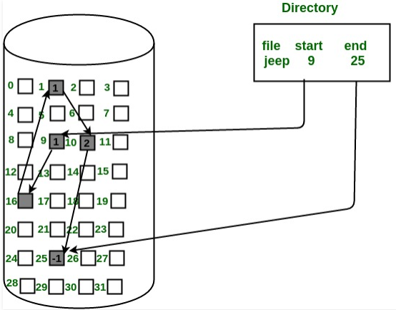
Cont…

Slide 18
Advantages:
This is very flexible in terms of file size. File size can be increased easily since the system does not have to look for a contiguous chunk of memory.
This method does not suffer from external fragmentation. This makes it relatively better in terms of memory utilization.
Disadvantages:
Because the file blocks are distributed randomly on the disk, a large number of seeks are needed to access every block individually. This makes linked allocation slower.
It does not support random or direct access. We can not directly access the blocks of a file. A block k of a file can be accessed by traversing k blocks sequentially (sequential access ) from the starting block of the file via block pointers.
Pointers required in the linked allocation incur some extra overhead.

Slide 19
3. Indexed Allocation
In this scheme, a special block known as the Index block contains the pointers to all the blocks occupied by a file.
Each file has its own index block. The ith entry in the index block contains the disk address of the ith file block.
The directory entry contains the address of the index block as shown in the image:

Slide 20
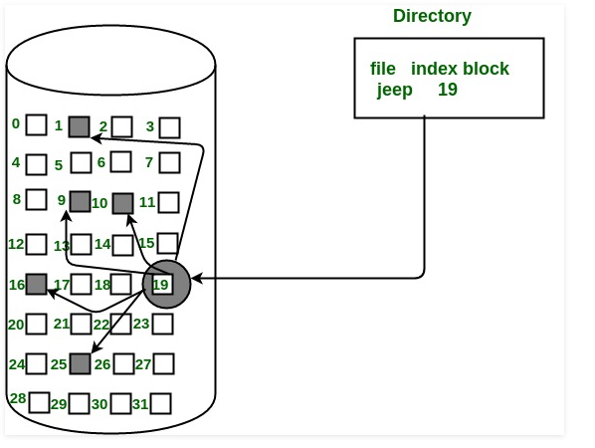
Cont…

Slide 21
Advantages:
This supports direct access to the blocks occupied by the file and therefore provides fast access to the file blocks.
It overcomes the problem of external fragmentation.
Disadvantages:
The pointer overhead for indexed allocation is greater than linked allocation.
For very small files, say files that expand only 2-3 blocks, the indexed allocation would keep one entire block (index block) for the pointers which is inefficient in terms of memory utilization.
However, in linked allocation we lose the space of only 1 pointer per block.

Slide 22
File System
A file system provides a way of organizing a drive. It specifies how data is stored on the drive and what types of information can be attached to files like filenames, permissions, and other attributes.
Operating systems add a directory structure to break the partition up into smaller files, assign names to each file, and manage the free space available to create new files.
The directory structure and methods for organizing a partition is called a File System.
Different File Systems reflect different operating system requirements or different performance assumptions.
It specifies the logical method of file storage in a computer system. Some of the commonly used files systems include FAT and NTFS.

Slide 23
File Allocation Table (FAT)
The data is stored in a very orderly pattern on each platter. Bits of data are arranged in concentric, circular paths called tracks. Each track is broken up into smaller areas called sectors.
Part of the hard drive stores a map of sectors that have already been used up and others that are still free. (In Windows, this map is called the File Allocation Table or FAT.)
When the computer wants to store new information, it takes a look at the map to find some free sectors.
Then it instructs the read-write head to move across the platter to exactly the right location and store the data there. To read information, the same process runs in reverse.

Slide 24
Cont…
When the system crashes, no data is lost. The CHKDSK (or on newer systems the SCANDISK) utility examines the FAT table to determine the status of every record on disk.
The FAT File system is used by DOS and is supported by all the other operating systems.

Slide 25
NTFS
NTFS provides everything. It supports long file names, large volumes, data security, and universal file sharing.
Because the other operating systems cannot use it, NTFS is less attractive on personal desktop workstations or portables.
NTFS is the most modern file system. Windows uses NTFS for its system drive and, by default, for most non-removable drives.
FAT is an older file system that’s not as efficient as NTFS and doesn’t support as big a feature set, but does offer greater compatibility with other operating systems.

Slide 26
The end
Thank you

